Slide 1
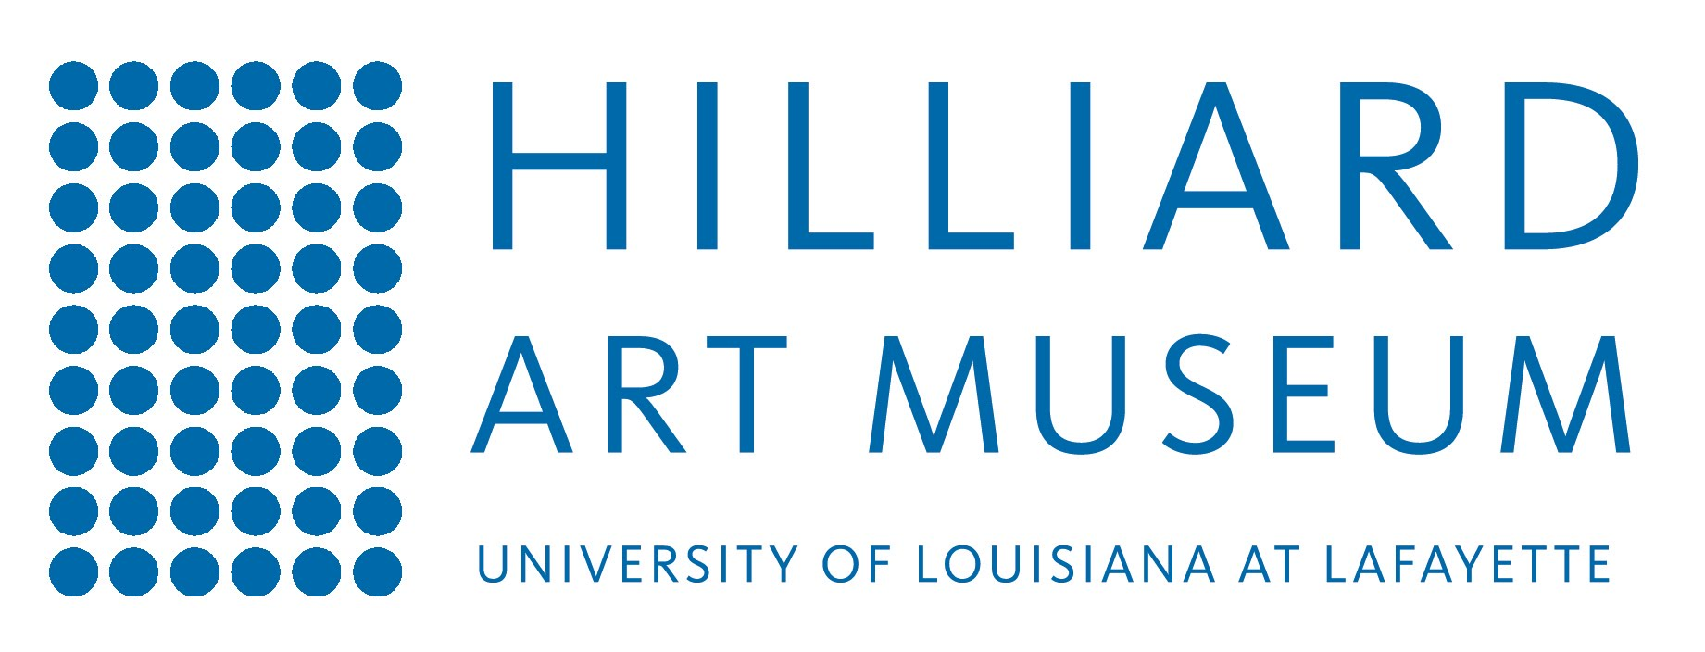
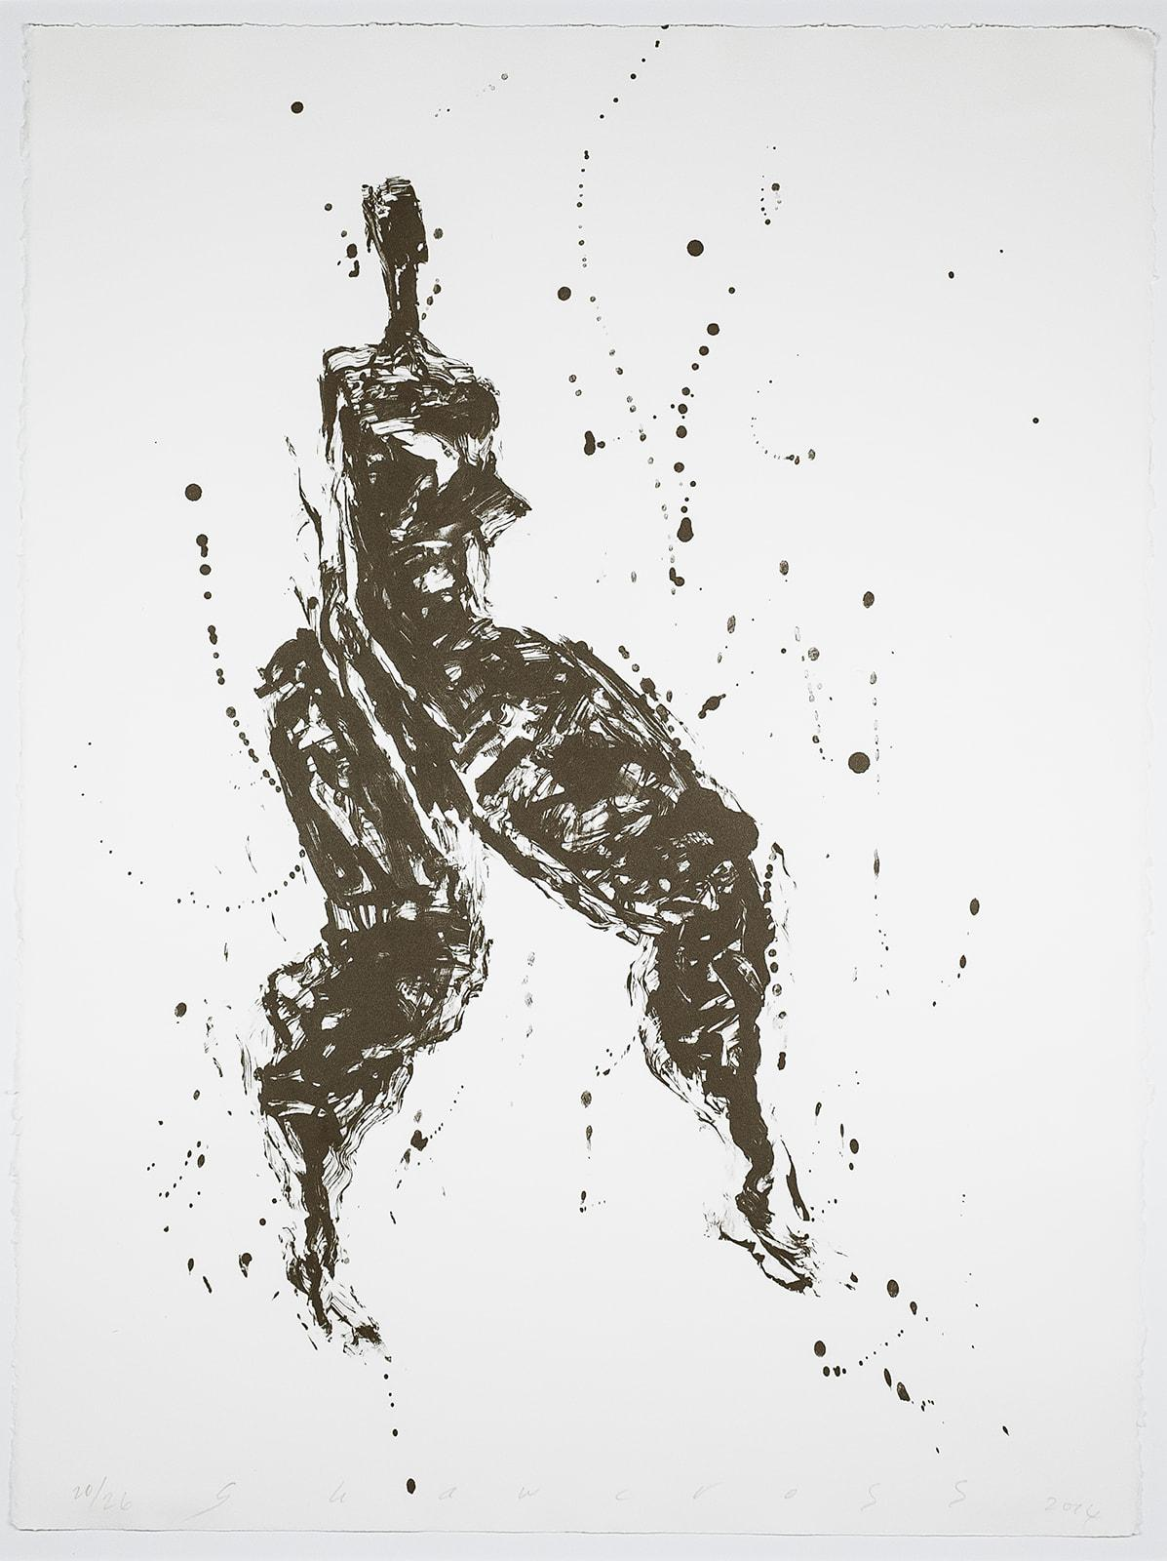
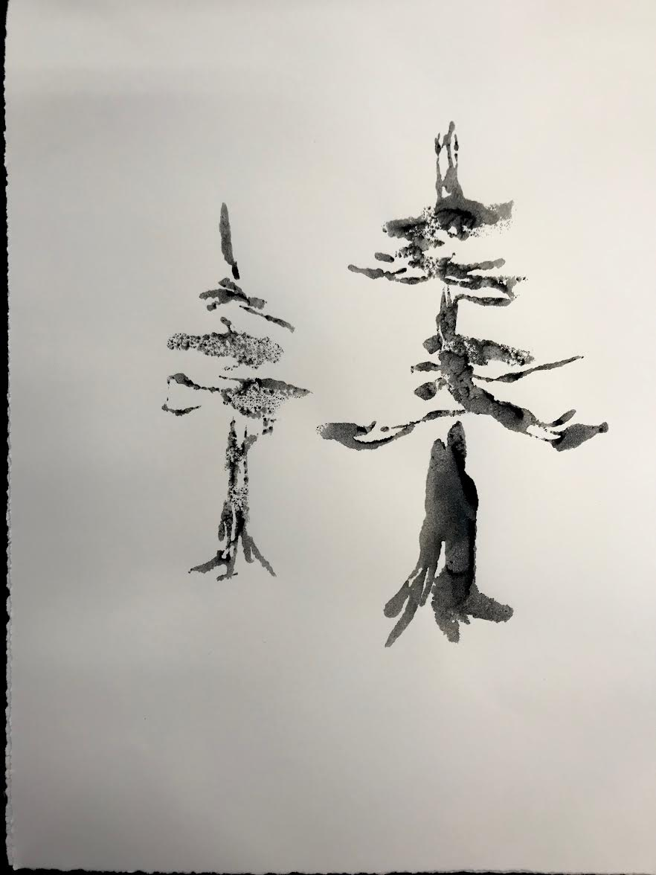
Marais Press Exhibition
Lesson Plan
Mark-making and Monotype with Neil Shawcross
By: Sharon Wright
UL Art Education
Fall 2021

Slide 2
Artist: Neil Shawcross
Title: Untitled 20/26
Year: 2014
Media: Lithography
Dimensions: H-30 x W 22.5 inches
Catalog Number: 2017.10.03
Marais Press Print Collection

Slide 3
Big Ideas and Connections
Shawcross is primarily a figure and still life painter from England. He admires some of Matisse’s work and mimics, in a way, his gestural mark-making, simplicity, colors, and imagery. Being that this is his approach in creating, students will learn his method of simple shape and mark-making. The students will respond to prompts and look at the brush strokes that contain spontaneity and how Shawcross plays with the space and imagery to create a simple composition.
Essential questions: What do you notice within the brush stroke? Is there value? Is it one shade of color? What does the weight of the line convey? Action? Movement? Rhythm?

Slide 4
Brief Overview
This lesson plan explores space, shape, and gestural mark-making and facilitates students' understanding of monotypes.

Slide 5
Objective
Students will be able to create a black and white monotype using gestural mark-making, shape, and space.

Slide 6
Visual Arts Standards
Creating: Anchor Standard 1: Generate and conceptualize artistic ideas and work.
Presenting: Anchor Standard 4: Select, analyze, and interpret artistic work for presentation.
Responding: Anchor Standard 8: Interpret intent and meaning in artistic work.

Slide 7
Materials List:
Gouache
Paint brushes
Paper
Water
Plexi glass
Spoon
Spray bottle
Paper towels

Slide 8
Vocabulary:
Composition- arrangement of balanced elements
Gouache- opaque watercolor
Gestural Mark-Making- mark-making that shows movement with each stroke
Monotype- single print; work quickly
Pull- pulling paper off of surface
Shape- a two-dimensional shape
Space- can be negative or positive/the space found between or in elements in a composition.

Slide 9
Choose your topic for your monotype!
Tree
Human figure/face
Animal (Fish, amphibian, mammal, reptile, insect)
Flower
Car
Landscape
Instruments

Slide 10
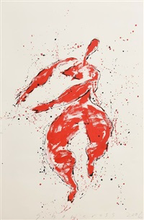
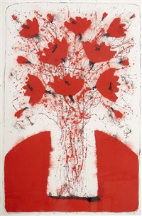
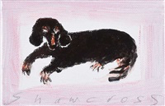
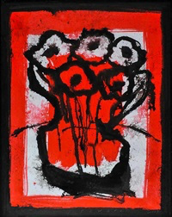
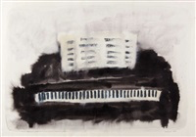
Neil Shawcross’s other artworks
Dachshund, 2019
Flowers, 2015
Homage to Henri Matisse, 2006
Still Life, 2007
Grand Piano, 2016

Slide 11
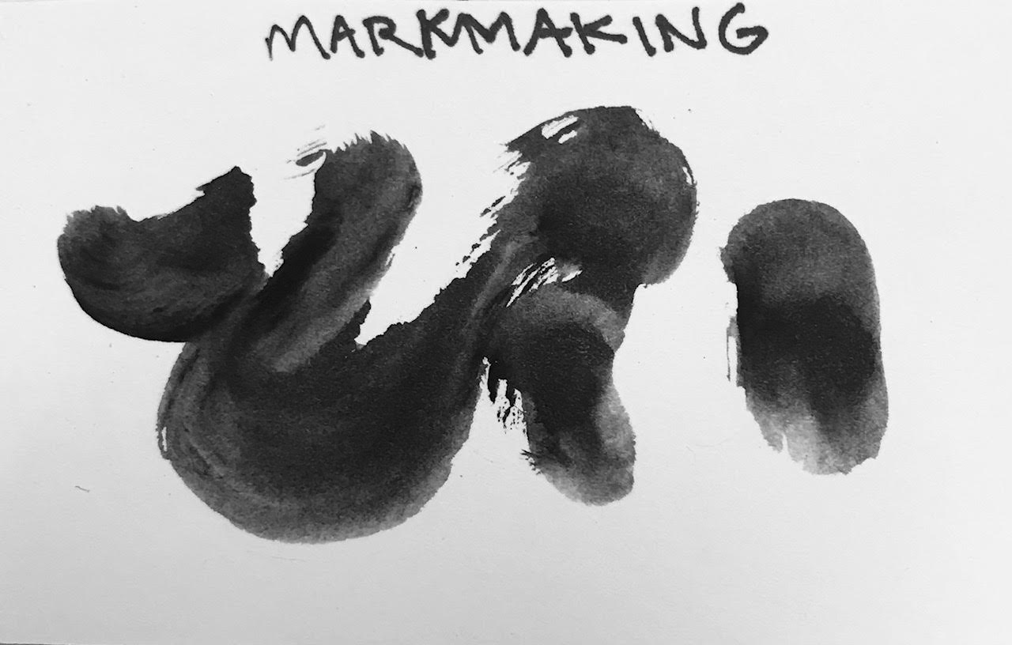
Gestural mark-making experiment
Students will practice mark-making with their paint brushes before making their final composition.
Talk about line weight, emotion, opacity of ink, etc.
Essential questions: What do you notice within the brush stroke? Is there value? Is it one shade of color? What does the weight of the line convey? Action? Movement? Rhythm?

Slide 12
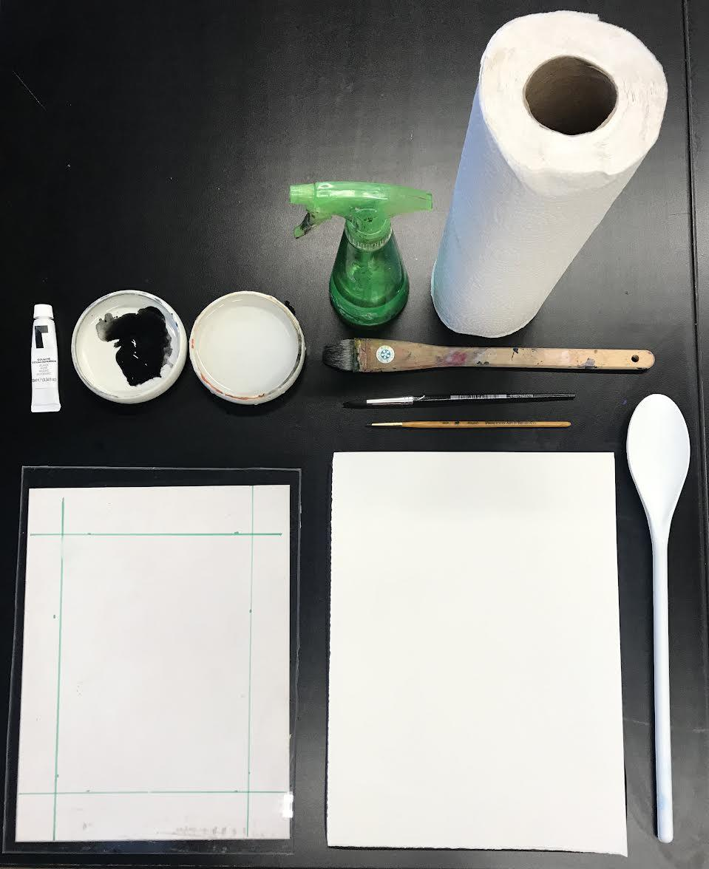
Process
Step 1
Gather Supplies:
Gouache
Paint brushes
Paper
Water
Plexi glass
Spoon or Brayer
Spray bottle
Paper towels

Slide 13
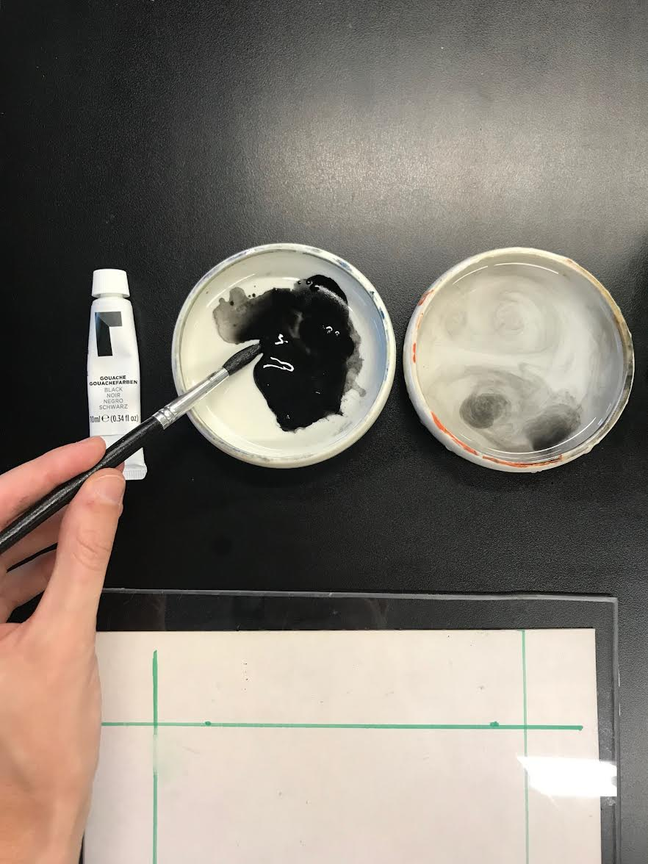
Step 2
Choose your desired paint brush and dip it into the gouache and water.
*Tip: Work quickly once the paint is on the plexi glass or else it will dry and not transfer to the paper.

Slide 14
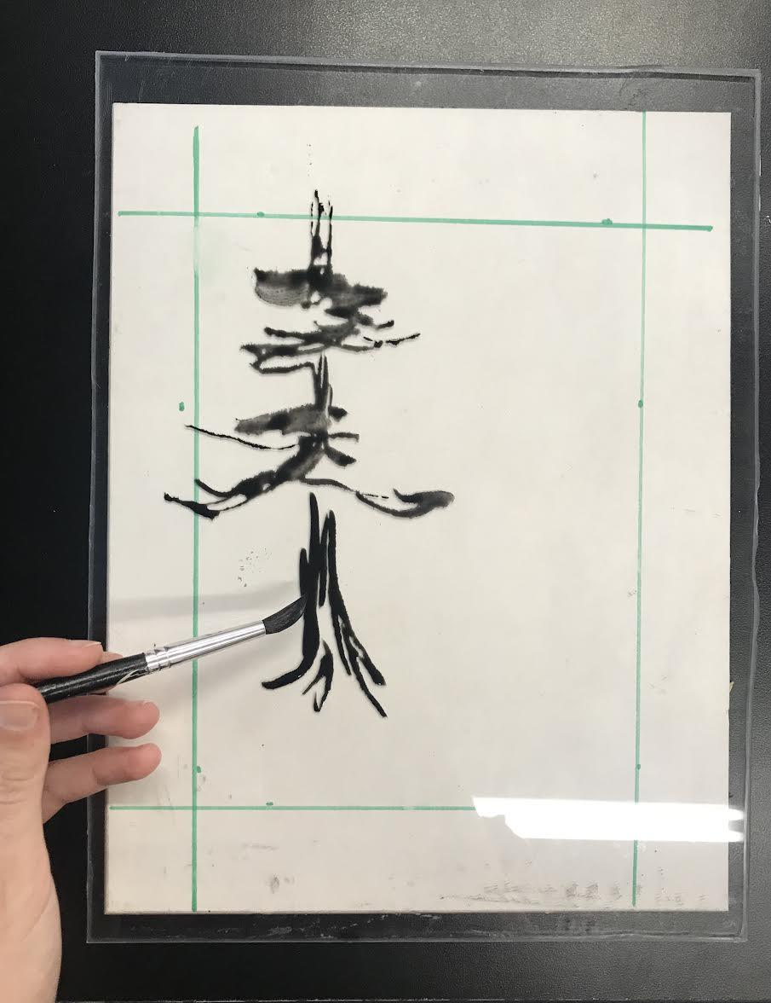
Step 3
Choose your imagery theme and paint your imagery onto the plexi glass. Incorporate space, shape, and gestural mark-making.

Slide 15
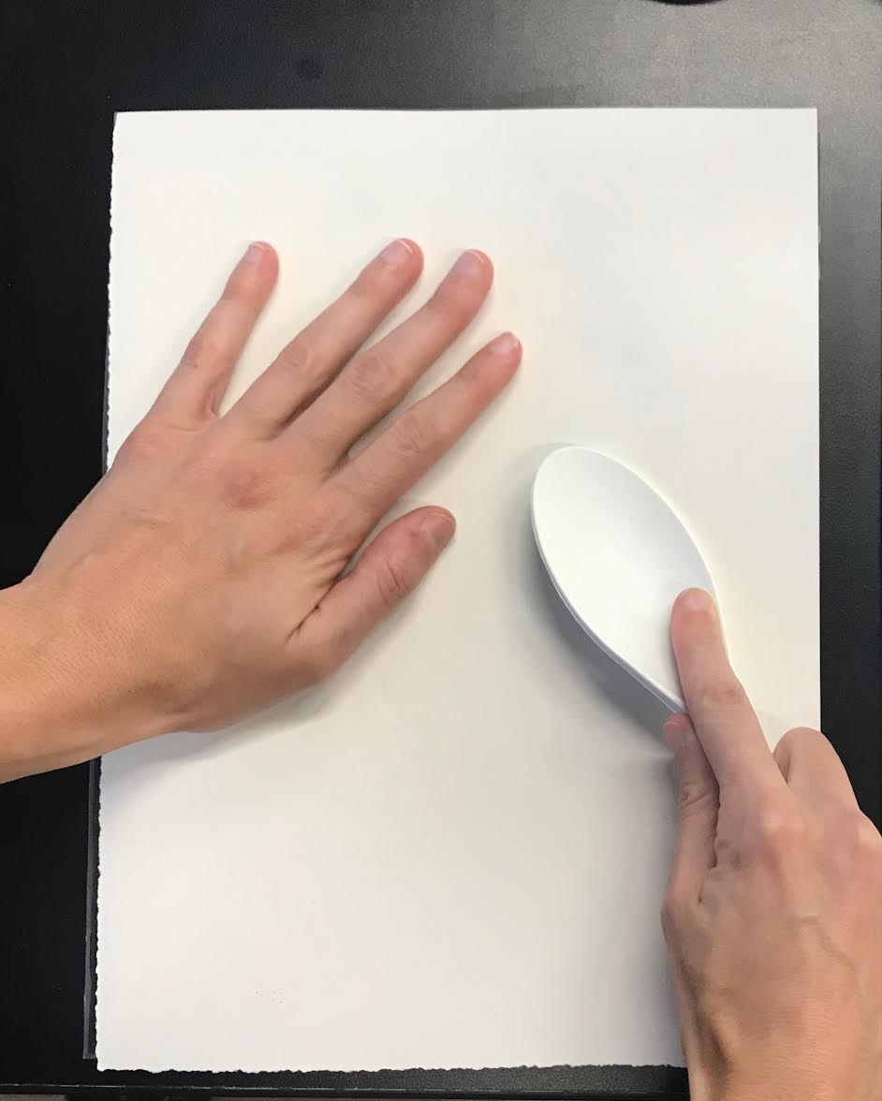
Step 4
Place the paper face down onto the imagery. Use one hand to hold the paper in place and rub the edge of the spoon on the paper to transfer the image to the paper.

Slide 16
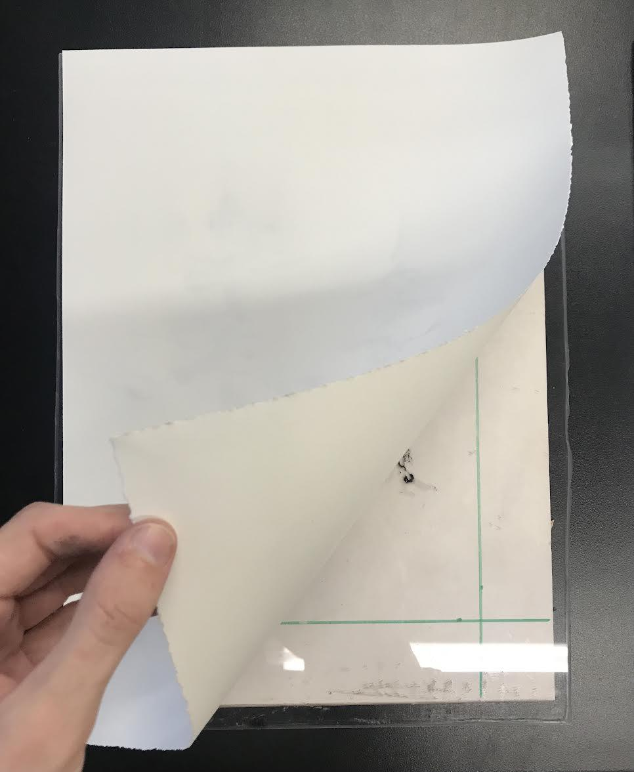
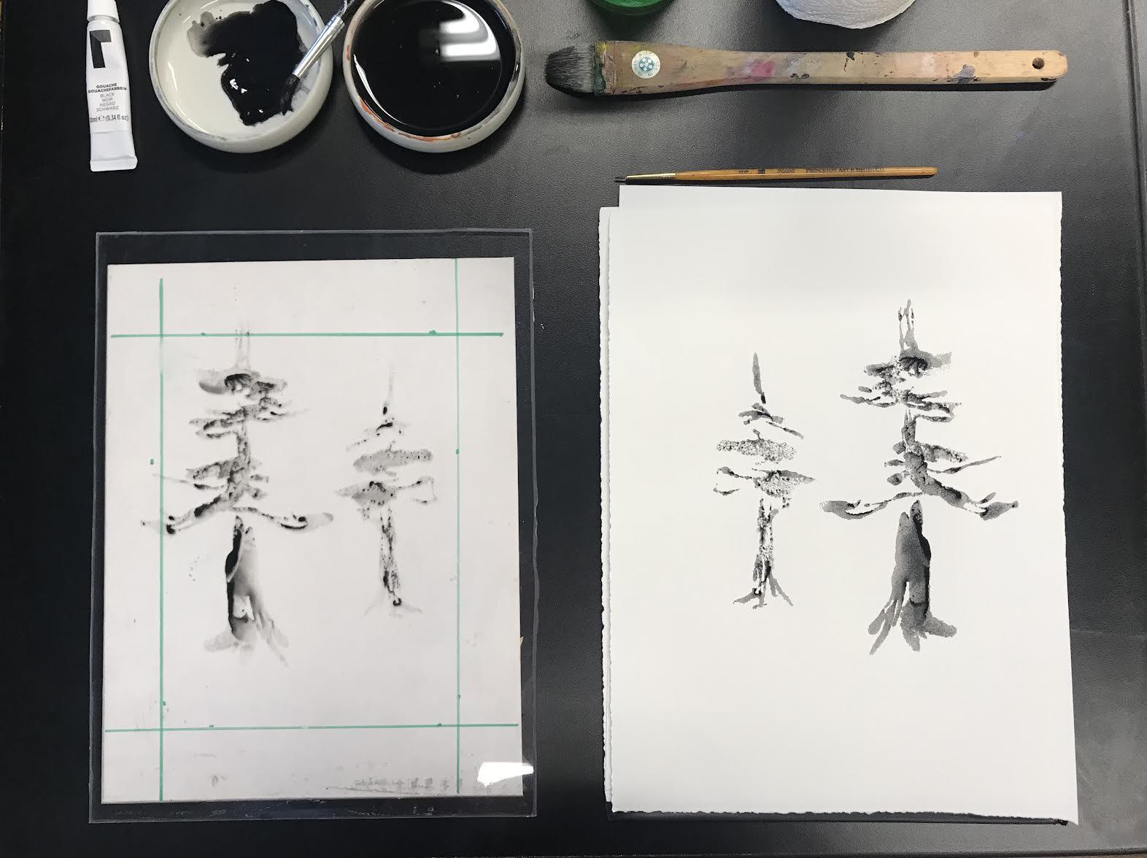
Step 5
Pull the paper away from the plexi glass to reveal your final image.

Slide 17
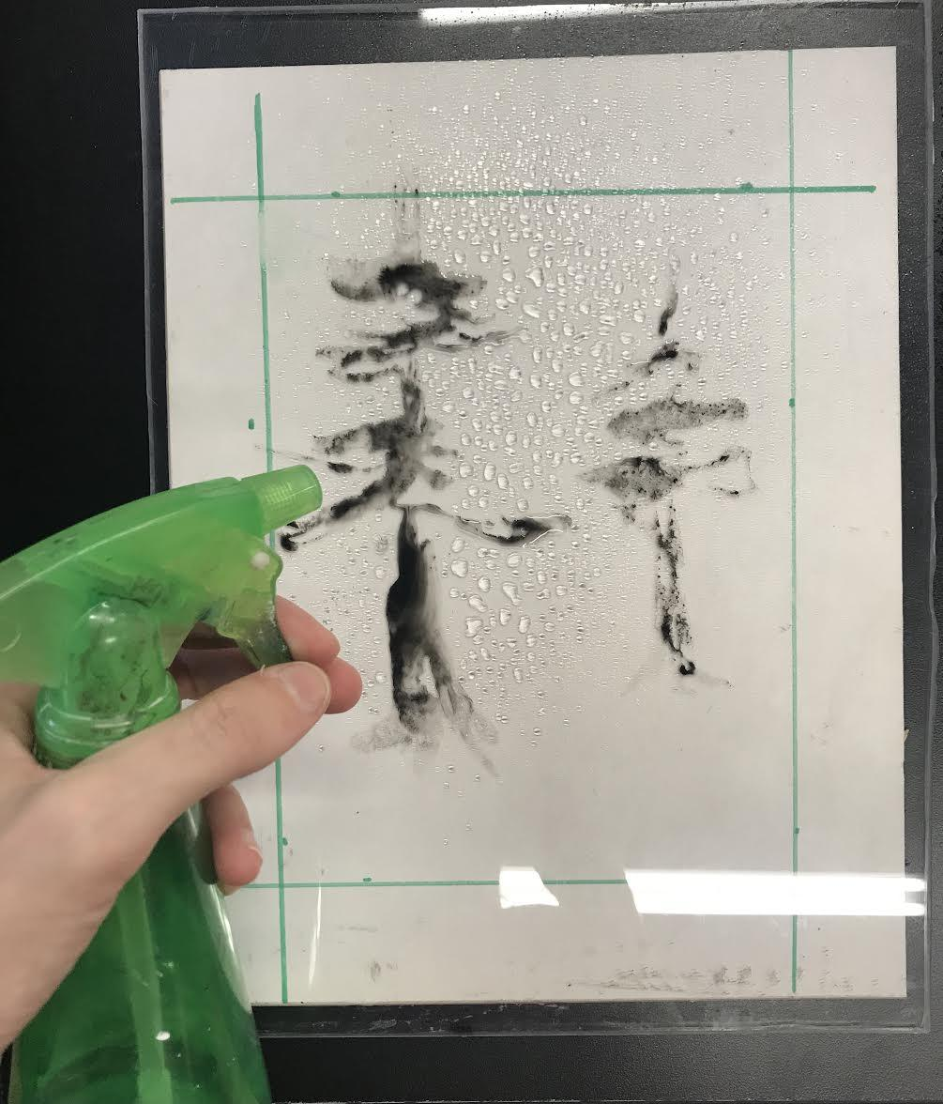
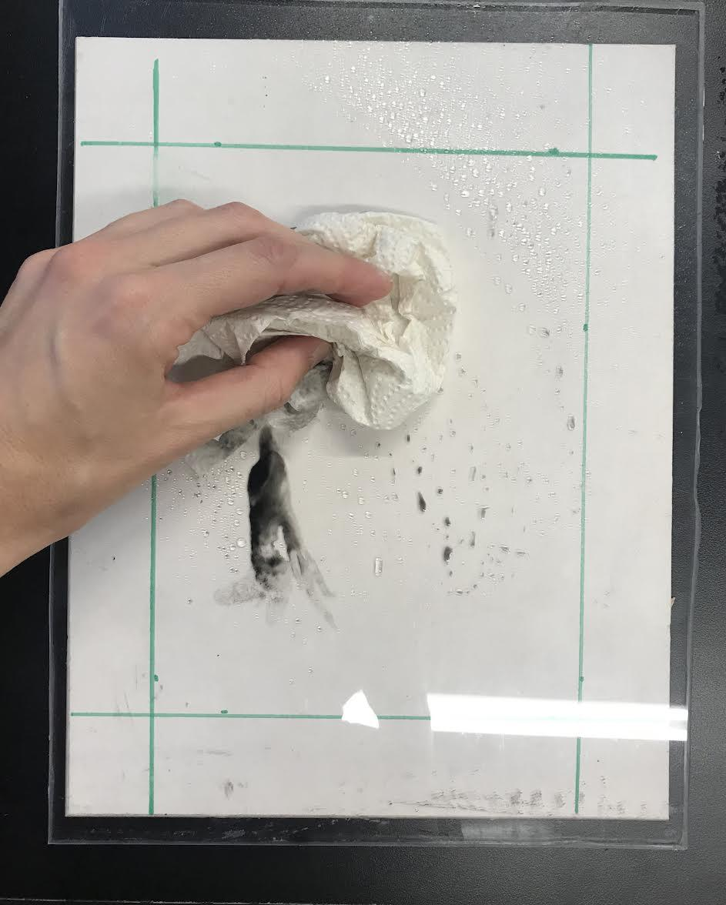
Step 6
Clean the plexi glass using the spray bottle and paper towels.

Slide 18
Step 7
Your Monotype is now complete!

Slide 19
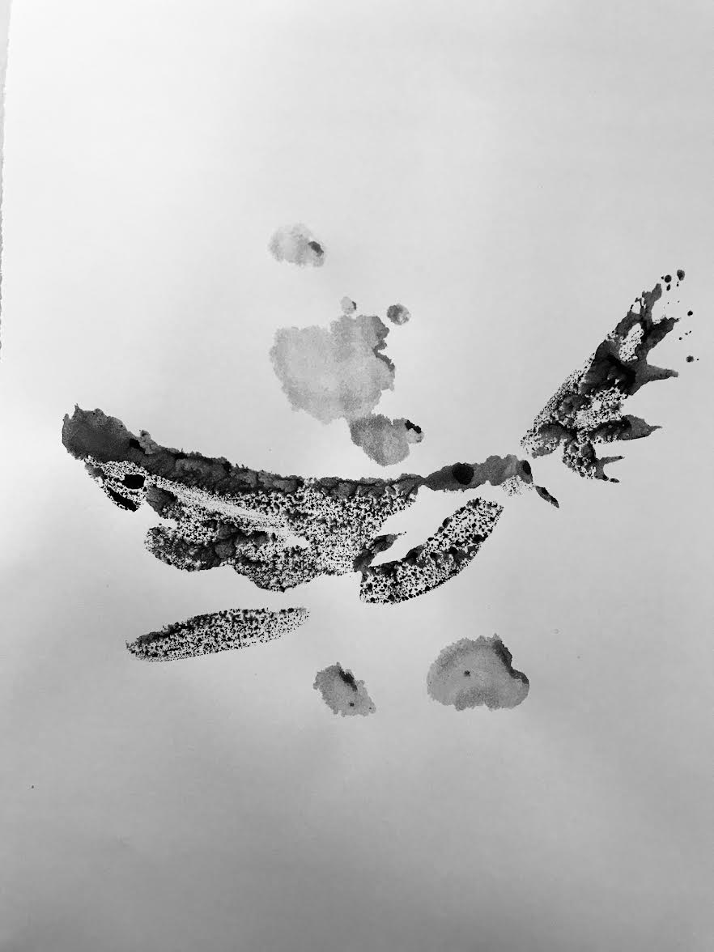
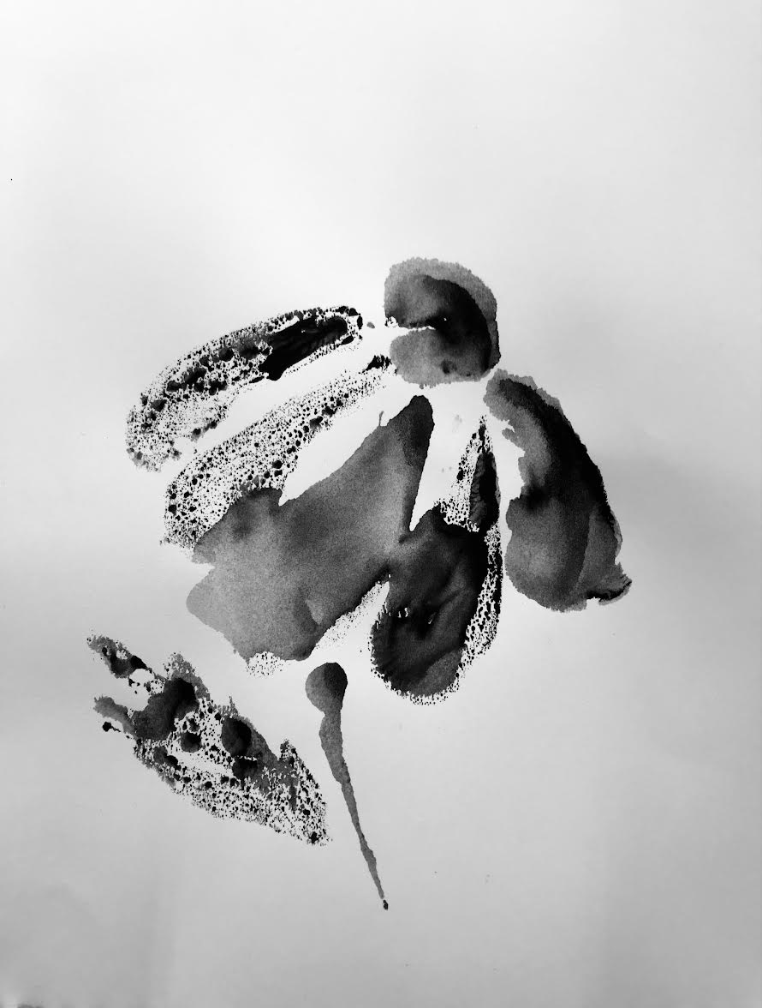
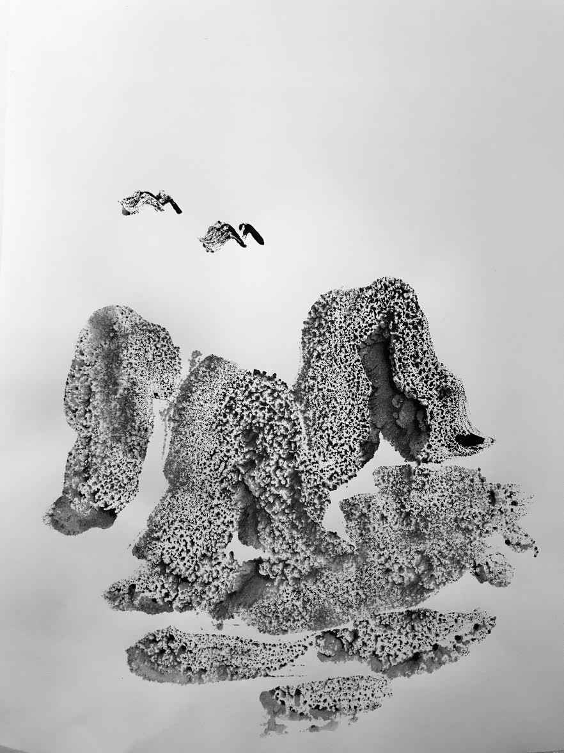
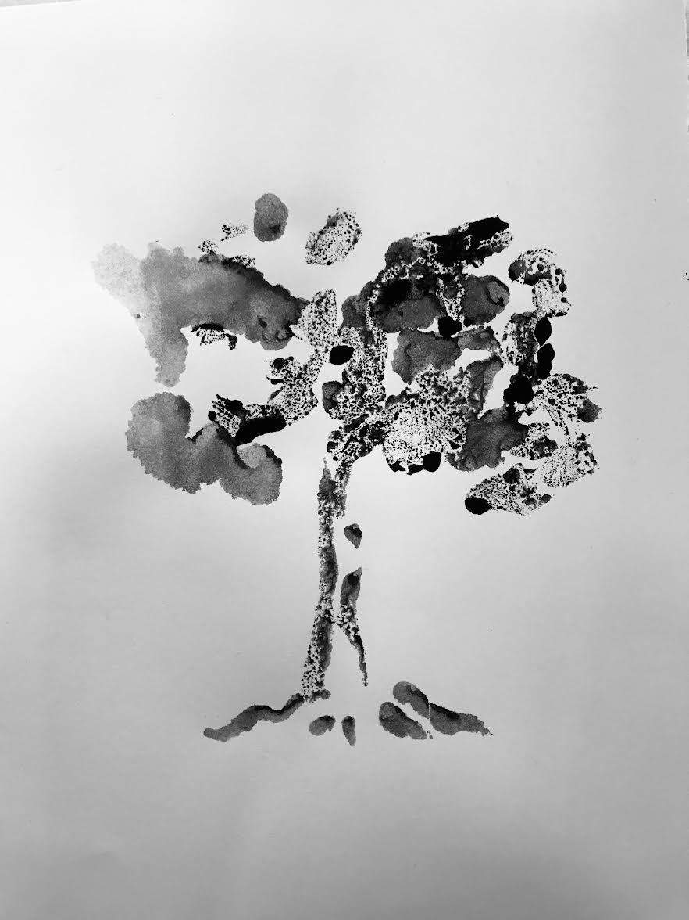
Other example monotypes:

Slide 20
Analytic Rubric
Objectives | Exceeds | Meets | Does Not Meet
Space (Negative) | Student shows understanding of space in their composition with intentional use of empty areas. | Student shows some understanding of space in their composition. Some areas are lacking negative space. | Student shows no understanding of space because of a cluttered composition.
Shape | Student shows understanding of shape by painting intentional figures/objects. | Student meets criteria of creating a shape but lacks some creativity and originality. | Student does not meet criteria of creating shapes in their composition.
Mark-making | Student exceeds criteria of making gestural marks in their work. | Student meets mark-making standard but lacks creativity and originality. | Student does not meet standard for mark-making and shows little to no understanding of gestural mark-making in their work.

Slide 21
References:
Artworks. Shawcross, Neil, b.1940 | Art UK. (n.d.). Retrieved October 28, 2021, from https://artuk.org/discover/artists/shawcross-neil-b-1940.
Wikimedia Foundation. (2021, October 25). Neil Shawcross. Wikipedia. Retrieved October 28, 2021, from https://en.wikipedia.org/wiki/Neil_Shawcross.

